Slide 1
MAS512 · Assignment 1
Object detection, tracking,
segmentation and classification
Group 5 · University of Agder · Autumn 2026
1
2
3
4
5
6
Are Gundersen, Sebastian Steenfeldt-Gjersøe

Slide 2
Overview
1
Object detection & depth
2
Object tracking
3
Multi-object segmentation
Train YOLO on L515 frames of a swinging load; KPIs, boxes, depth
Trajectory of the load in test_swingingload.avi
Segment, count, track persons; count inside a region
45 p
5 p
10 p
4
Classification
5
CIFAR-10 classification
6
Autoencoder
Motor state-of-health model vs. class baseline
Model fusion, transfer learning, fine-tuning
Latent compression & reconstruction of fault images
10 p
20 p
10 p

Slide 3
1
Object detection and depth estimation
Objective
Data
Detect a swinging load in RGB frames from the Intel RealSense L515
Train and validate a YOLO model (YOLO_swinging_load.pt) on a 30 s recording
Evaluate on an independent 5 s test recording and read out depth at the load centre
Train/val: rgb_train_val_swingingload.avi → PNG frames
Test: test_swingingload.avi → RGB frames + raw depth (.npy)
Single class: Payload
Pipeline
Acquire
L515 video
›
Extract
frames
›
Auto-annotate
(background subtraction)
›
Split
80 / 20 train / val
›
Train
YOLO11n
›
Test &
read depth
Q1 · Script: Q1_ObjectDetection.py

Slide 4
1
Method
Automatic annotation
Dataset & training
Evaluation
Background B = per-pixel median over all grayscale frames
Difference |I − B| smoothed with Gaussian (σ = 1.5)
Pixels with diff > 55 marked as moving
Outliers (rope, shadows) removed: keep pixels within 70 px of the mean
Bounding box = extent of remaining pixels → YOLO label (class 0, normalised cx, cy, w, h)
Labelled train frames shuffled, 20 % held out for validation (seed 0)
data.yaml with train / val / test splits, 1 class
Base model: yolo11n.pt (pretrained on COCO)
imgsz 640, batch 32, up to 100 epochs, early stopping patience 10
Best weights saved as YOLO_swinging_load.pt
model.val() on the test split → precision, recall, mAP50, mAP50-95
Prediction: most confident box per frame, conf ≥ 0.5
Depth: median of a 5×5 window around the box centre in the raw depth frame, × 0.00025 m/unit
Q1 · Why automatic annotation: one moving object on a static background makes background subtraction reliable and saves manual labelling of hundreds of frames.

Slide 5
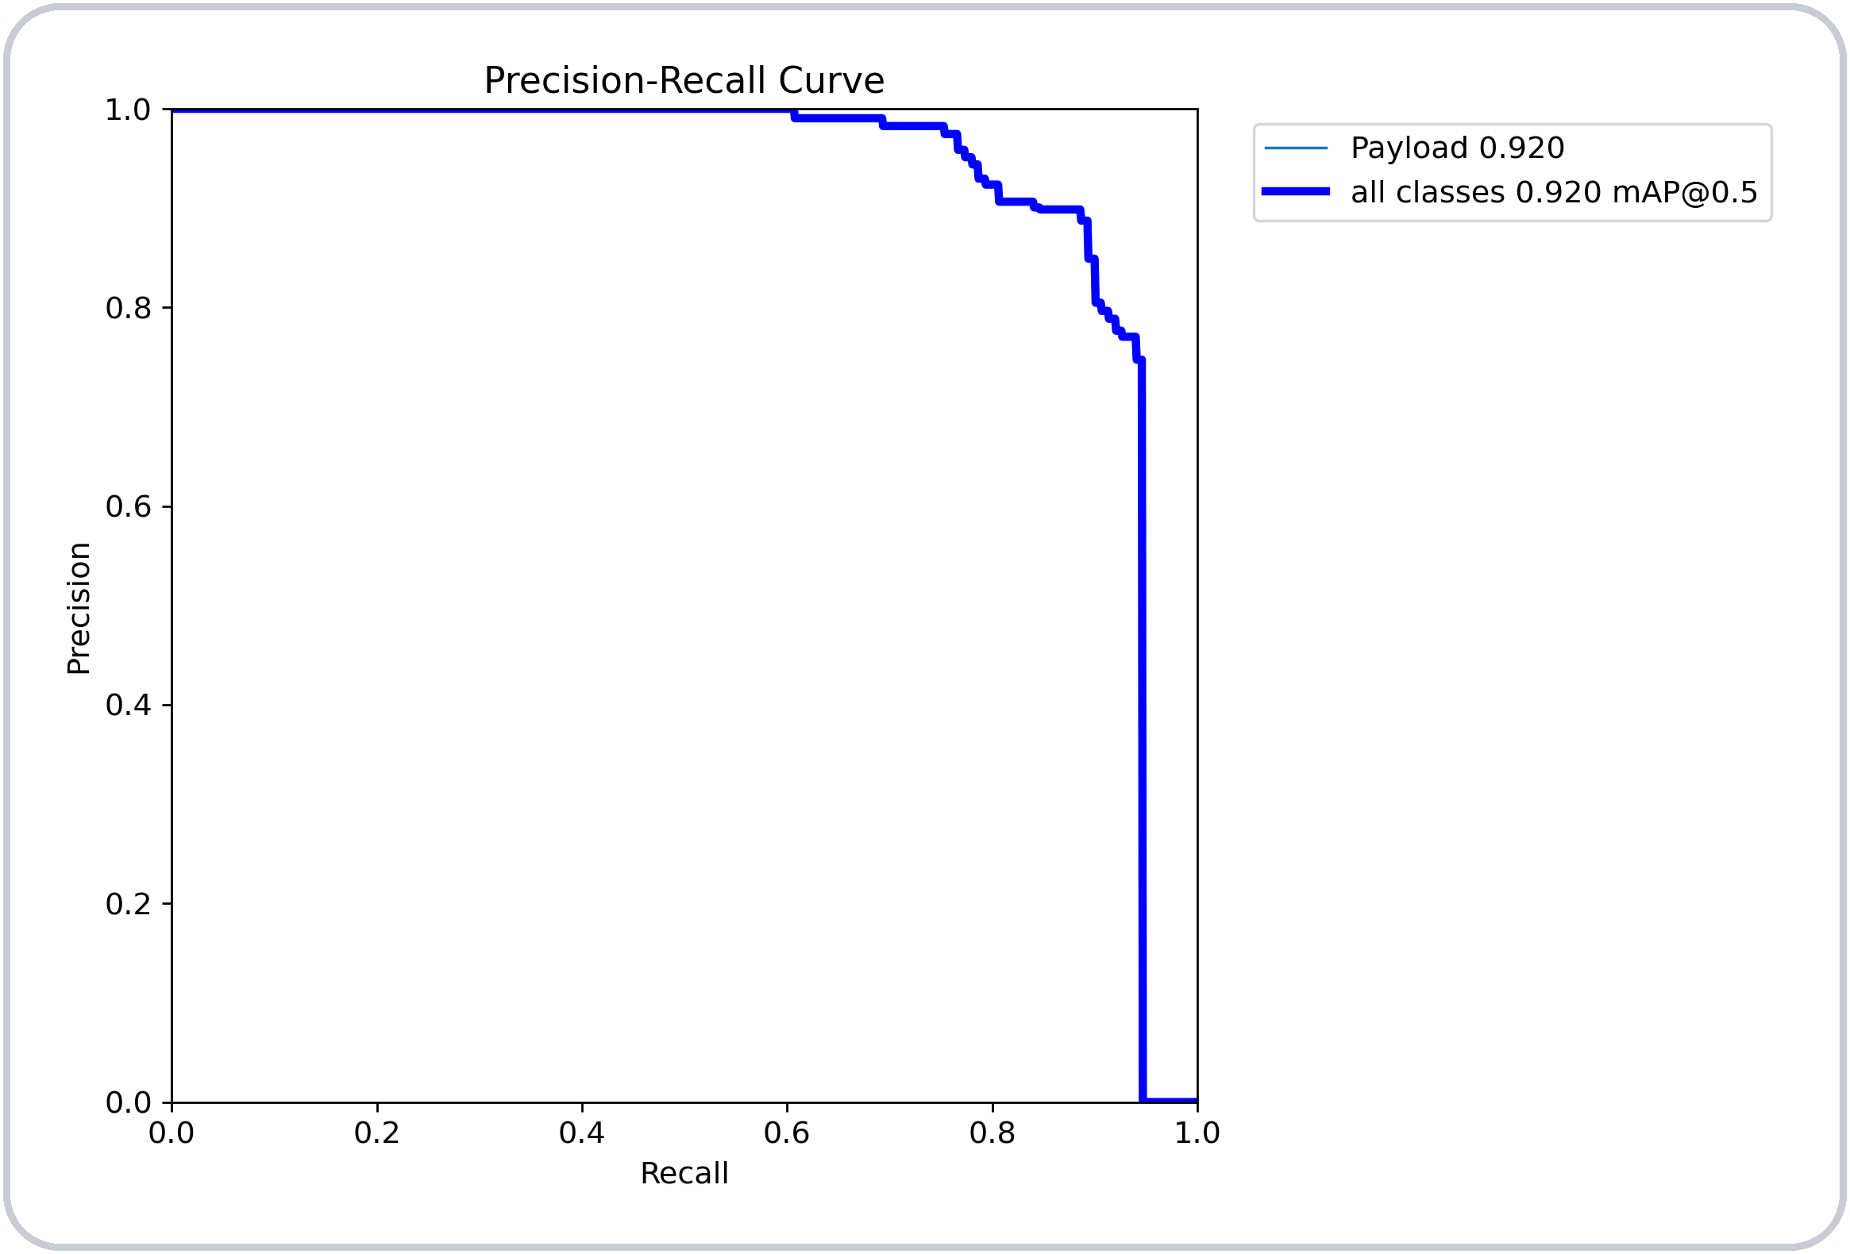
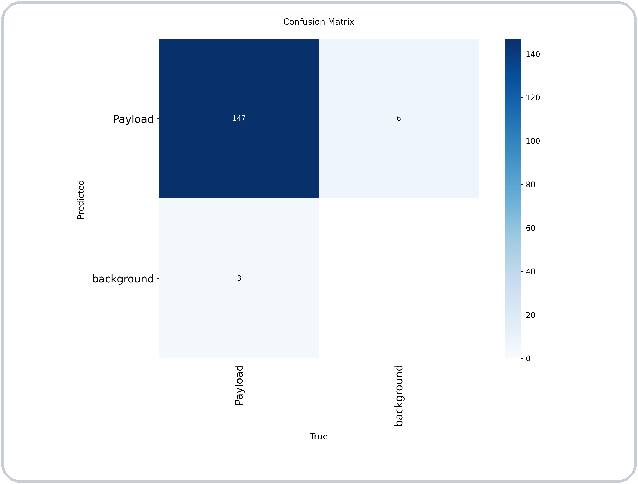
1
Results (a) — performance on the test set
0.898
0.887
0.920
0.312
Precision
Recall
mAP50
mAP50-95
Q1 · P and R reported at the F1-optimal confidence (0.52). Confusion matrix (conf 0.25): 147 detected, 3 missed, 6 false positives of 150 test frames.

Slide 6
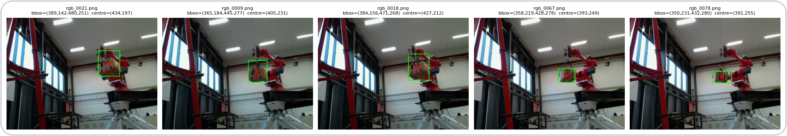
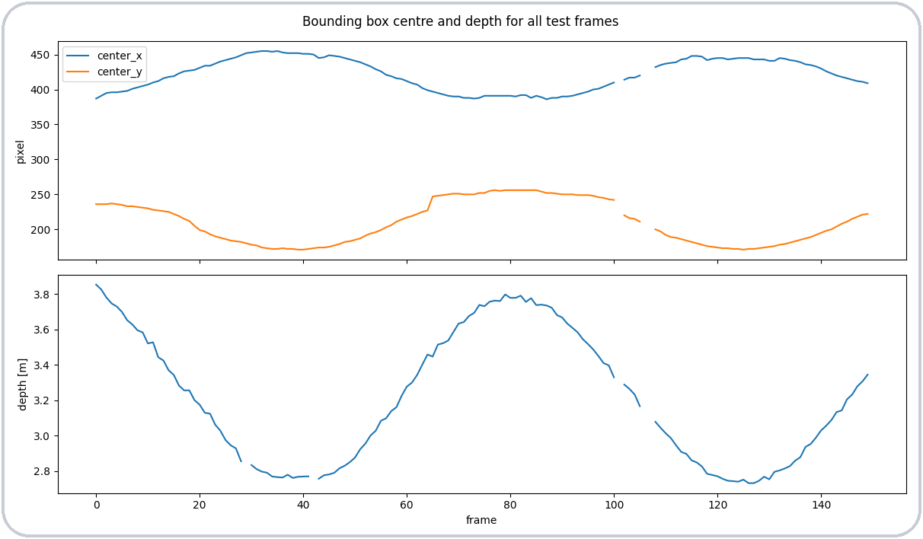
1
Results (b) & (c) — boxes, centres and depth
(c) Centre & depth for all test frames
Load detected in 147 of 150 frames (missed frames 101, 106, 107)
Valid depth in 145 frames (0 = no L515 measurement)
Depth 2.73 – 3.86 m (median 3.16 m); the swing period is visible in both centre_x and depth
Q1 · Depth read from depth_raw/*.npy (not the depth video) to avoid colour-map quantisation. Full table: runs/q1c_center_depth.csv

Slide 7
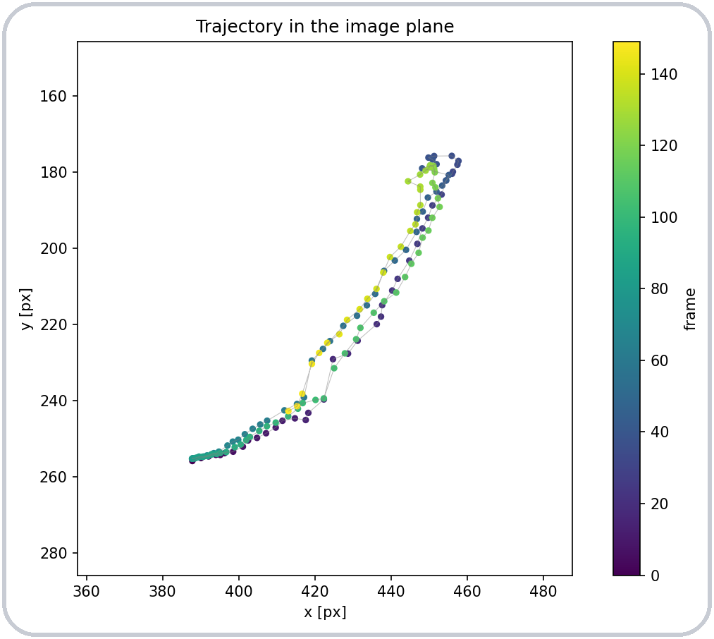
2
Object tracking — load trajectory
Objective
Method
Track the load through every frame of test_swingingload.avi
Display the trajectory in the image plane, as in the reference figure
Run YOLO_swinging_load.pt frame by frame (conf ≥ 0.5)
One load → keep the most confident box per frame
Log frame, time, centre (cx, cy), box size and confidence to trajectory.csv
Plot cx vs. cy coloured by frame index (viridis) with a thin connecting line; y-axis inverted to match image coordinates
Q2 · Result: load detected in 150 of 150 frames (100 %) over 5.0 s; the trajectory traces the pendulum arc, with both swing directions overlapping. Script: Q2_ObjectTracking.py

Slide 8
3
Segmentation, tracking and counting
Objective
Model & tracker
Dataset / class chosen: COCO / person
Video with several people in the scene (pedestrians.mp4)
(a) instance segmentation, (b) counting, (c) per-instance tracking, (d) counting inside a drawn region
yolo11n-seg.pt — pretrained on COCO-seg, no training needed
ByteTrack (persist=True) for stable IDs across frames
Only class 0 (person), conf ≥ 0.4
Per frame
model.track()
masks + boxes + IDs
›
(b) count boxes
+ collect unique IDs
›
box centre
(cx, cy)
›
(d) pointPolygonTest
inside region?
›
draw region,
counters, video out
Q3 · Region = upper half of the frame, defined as a polygon so it scales with the video resolution. Notebook: Q3

Slide 9
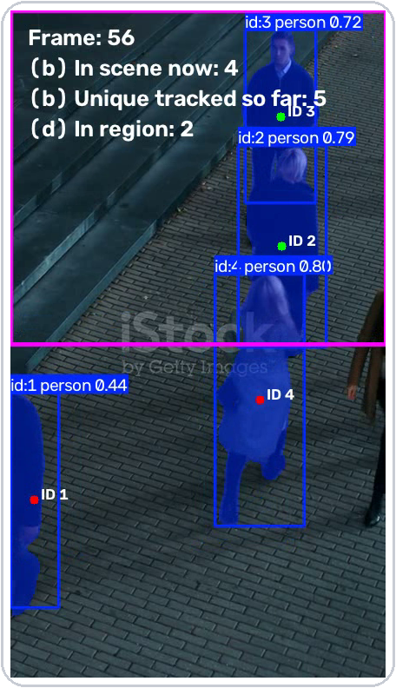
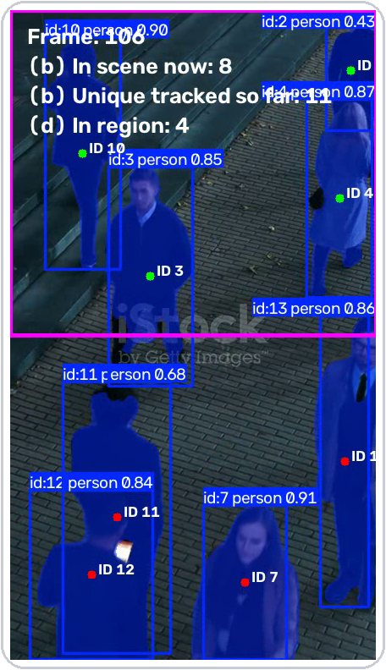
3
Results
14
unique persons tracked over 217 frames (b)
8
max persons in scene at once (b)
4
max persons inside region (d)
Frames 56 and 106 of q3_output.mp4 — masks and IDs (blue), region (magenta), centre dot green = inside
Q3 · 432×768 px, 25 fps, 8.7 s. Highest ID assigned is 19 while 14 were confirmed: ByteTrack drops short-lived tracks, and occlusions cause a few ID switches.

Slide 10
4
Classification — motor state of health
Objective
Method
Classify motor health: healthy or faulty
Compare our CNN with the class baseline
60×175 RGB, 80/20 train/val + test set
Adam, LR 1e-4, 15 epochs — same for both
60×175×3
4
8
8
16
144
16
16
2
64
64
2
Baseline
9 339 parameters
60×175×3
8
16
32
32
16
2
Our model
Numbers = filters / units
6 594 parameters
Input
Normalise
Conv 3×3
MaxPool
BatchNorm
Flatten
GAP
Dense
Dropout
Softmax

Slide 11
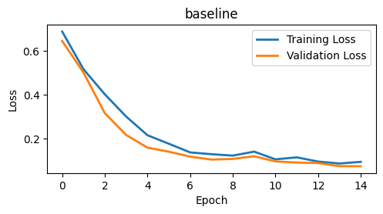
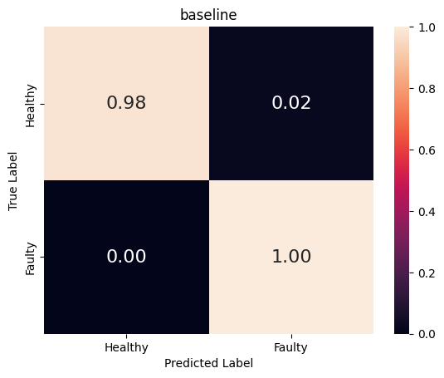
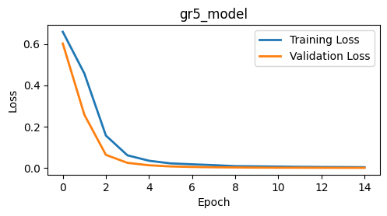

4
Results — our model vs. baseline
Model | Parameters | Inference [ms/img] | Accuracy | Precision | Recall | F1
Baseline | 9 339 | 0.539 | 1.000 | 1.000 | 1.000 | 1.000
Our model | 6 594 | 0.370 | 0.985 | 0.971 | 1.000 | 0.985

Slide 12
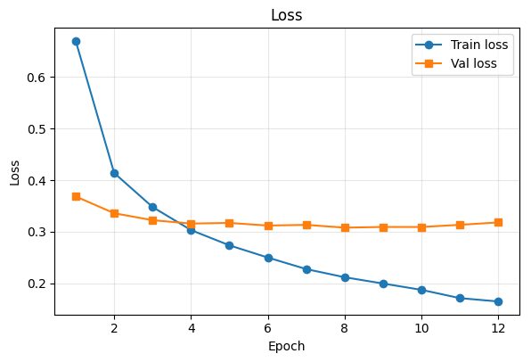
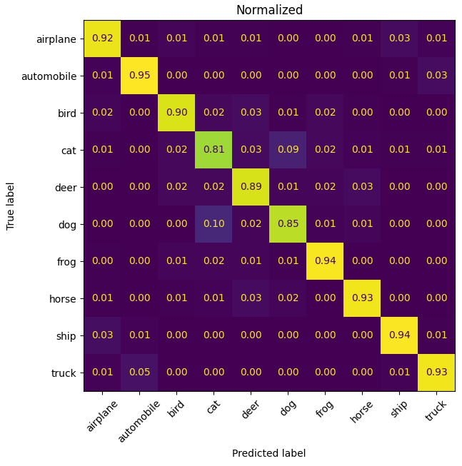
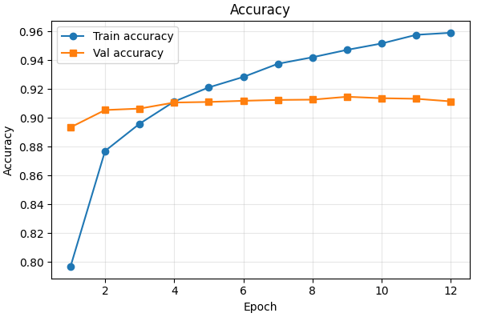
5
(a) Model fusion
Method
Graphs
Confusion matrix
MobileNetV2 + ResNet50
frozen
LR 1e-4
0.909
test accuracy

Slide 13
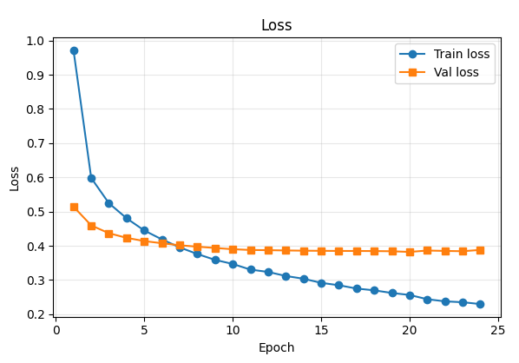
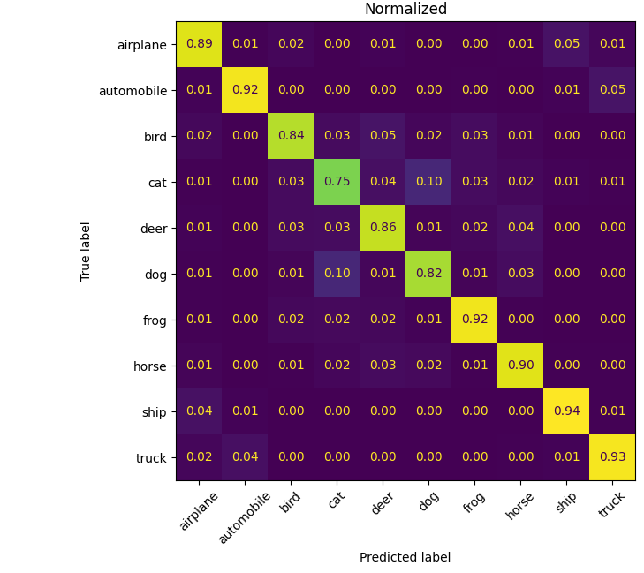
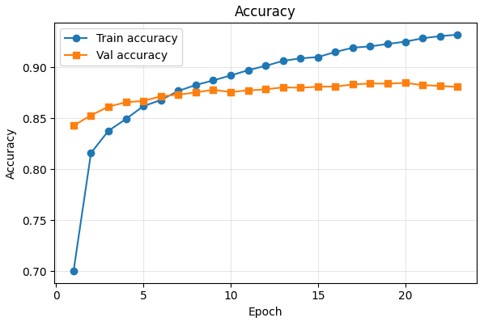
5
(b) Transfer learning
Method
Graphs
Confusion matrix
MobileNetV2, frozen
Only the head is trained
LR 1e-4
0.876
test accuracy

Slide 14
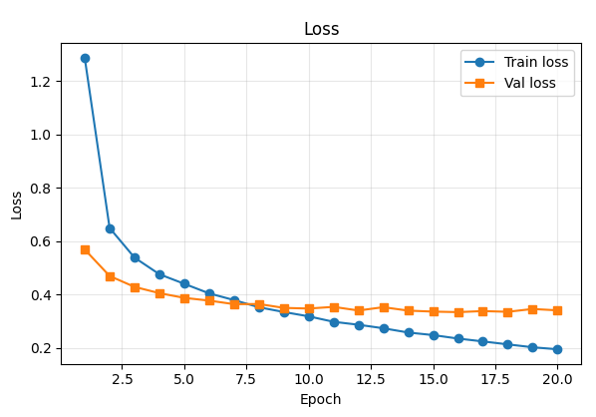
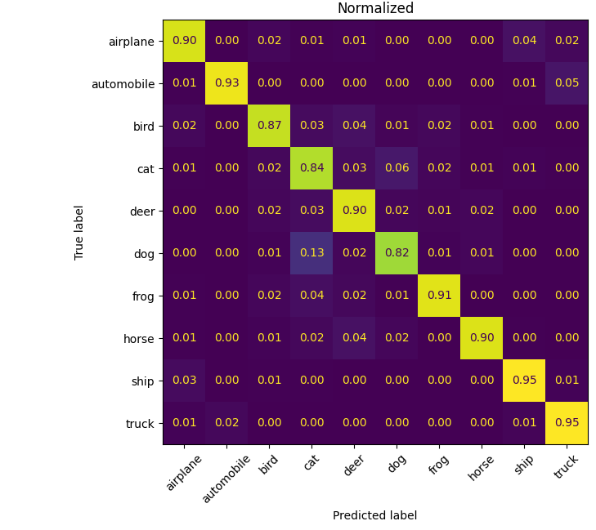
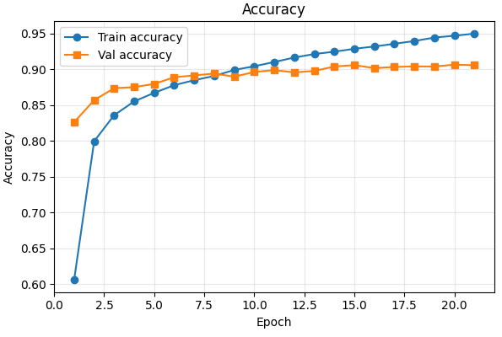
5
(c) Fine-tuning
Method
Graphs
Confusion matrix
MobileNetV2, top 25 layers unfrozen
Same head as (b)
LR 1e-5
0.897
test accuracy

Slide 15
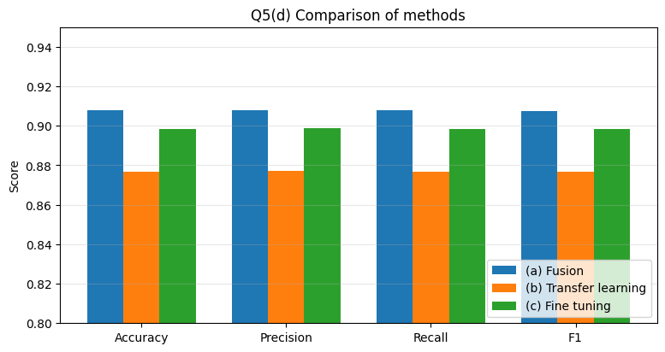
5
(d) Comparison of methods
Method | Total params | Trainable | Accuracy | Precision | Recall | F1 | Epochs | Train time
(a) Fusion | 26.7 M | 861 k | 0.909 | 0.910 | 0.909 | 0.909 | 11 | 125 s
(b) Transfer learning | 2.6 M | 333 k | 0.876 | 0.875 | 0.876 | 0.875 | 24 | 96 s
(c) Fine-tuning | 2.6 M | 1.69 M | 0.897 | 0.899 | 0.897 | 0.898 | 20 | 98 s
Fusion
Cat ↔ dog
best accuracy, but 10× larger
hardest pair for all methods

Slide 16
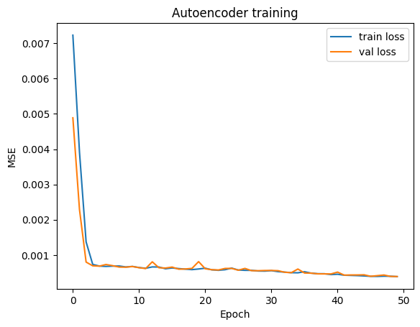
6
Autoencoder — compress and reconstruct
Objective
Compress images to 32 values and reconstruct them
Show original, latent, reconstruction and MSE
Method
60×175 grayscale input
10500 → 256 → 32 → 256 → 10500
MSE loss, Adam, 50 epochs
80/20 train/val, test set for results
Q6 · Train and val loss overlap → no overfitting.

Slide 17
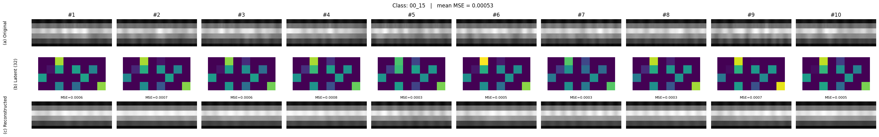
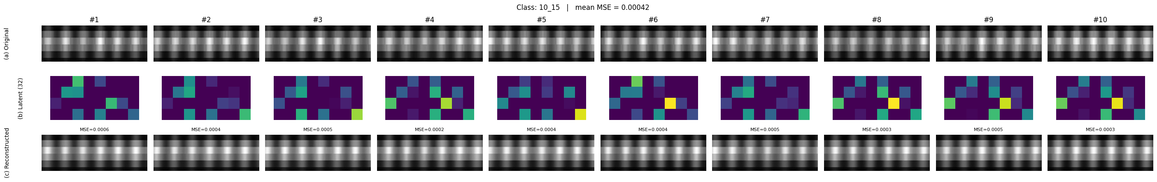
6
Results — reconstruction per class
0.00053
0.00042
mean MSE · healthy (00_15)
mean MSE · faulty (10_15)
Healthy motor is reconstructed best
Q6 · Latent colour scale is shared within each figure.

Slide 18
Summary
1
YOLO11n trained on auto-annotated L515 frames: mAP50 = 0.92 (mAP50-95 = 0.31) on unseen test video; depth read at the box centre
2
Trajectory of the load recovered in 100 % of the 150 test frames
3
Pretrained COCO segmentation + ByteTrack: 14 persons tracked, up to 8 at once, region counting works without any training
4
Motor classifier: 98.5 % accuracy (baseline 100 %) with 30 % fewer parameters and $\sim$30 % faster inference
5
CIFAR-10: fusion best (90.9 %), fine-tuning 89.7 % at 1/10 the size
6
Autoencoder: 10 500 → 32 values, mean MSE ≈ 0.0005 for both classes

